Slide 1


Social
Buzz Data
Analysis

Slide 2


Today's agenda
Project recap
Problem
The Analytics team
Process
Insights
Summary

Slide 3

Social Buzz is a fast growing technology unicorn that need to adapt quickly to it’s global scale.
Accenture has started a three-month project with a focus on these tasks:
An examination of Social Buzz's use of big data.
Analysis to determine the top 5 most popular content categories on Social Buzz. Suggestions for a successful first public offering.
Project Recap

Slide 4


Over 100,000 posts per day
36,500,000 pieces of content per year!
But how to capitalize on it when there is so much?
Analysis to find Social Buzz’s top 5 most popular categories of
content
Problem

Slide 5
Process
1 Data Understanding
2 Data Cleaning
3 Data Modelling
4 Data Analysis
5 Uncover Insights

Slide 6

Insights
16
Unique
Categorie
25k
Total
Reaction
974k
Reaction
Score
75K
Reaction to most popular post

Slide 7
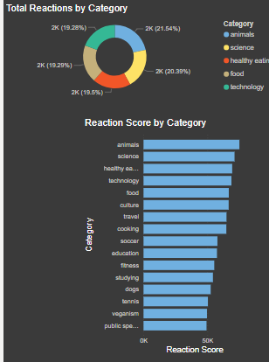

Slide 8

Analysis
Animals and science are the two categories
of content showing “real
-life” and “factual”
content
Insight
Food is a common theme with the top 5
categories with “Healthy Eating” ranking the
highest. This may given an indication to the
audience within your user base. You could
use this insight to create a campaign and
work with healthy eating brands to boost
user engagement
Next Steps
The ad
-hoc analysis is insightful, but it’s time
to take this analysis into large scale
production for real
-time understanding of
your business. We can show you how to do
this
Summary

Slide 9

Thank you!
ANY QUESTIONS?

